Slide 1
Cybersecurity Incident Response Framework
Investigating a Conti ransomeware Incident

Slide 2
Presented by:
Mohamed Samir Helmy Mohamed
Mohammad Hesham Mohammad Abdelhamed
Muhammad Soudi Yousef
Menna Mohamed Salman Mahmoud Badr Abdelhamid
Mohamed Mohsen Gamal

Slide 3
Purpose of the Project:
To develop a robust incident response framework.
What we will focus on :
Overview of cybersecurity concepts and threats.
Create a Detailed incident response plan.
system hardening, secure architecture, and access control measures.
develop a Playbook to help handling various types of incident
Simulation of cybersecurity incident of Conti Ransomware.
Applying the created IR plan in into incident
Writing Response documentation including containment, eradication, and recovery steps.

Slide 4
Who We Are
We are a dedicated third-party incident response team specializing in comprehensive cybersecurity services.
Our Services Include:
Incident Investigation: Analyzing the breach, understanding the attack vector, and assessing impact.
Containment and Eradication: Implementing measures to contain the incident and eliminate threats.
Recovery: Assisting with system restoration and ensuring vulnerabilities are addressed.
Threat Intelligence: Providing insights into emerging threats and post-incident reporting.
Training and Preparedness: Offering training sessions for staff to prevent future incidents.
Current Focus: We are currently investigating a ransomware incident affecting the company, ensuring a swift and effective response to minimize damage and restore operations.

Slide 5
Tools and Techniques for the project:
Our Incident response plan is based on
NIST Cybersecurity Framework
Cyber kill chain Framework
For incident simulation we will use tryhackme.com website
Discuss the Conti ransomware walkthrough
Use Splunk SIEM to investigate the attack
We used some refences in our project
CompTIA Security+
Certified Information Systems Security Professional (CISSP):
OWASP (Open Web Application Security Project):
NIST (National Institute of Standards and Technology):
CERT (Computer Emergency Response Team):

Slide 6
What is cybersecurity?
Cybersecurity is the practice of defending computers, servers, mobile devices, electronic systems, networks, and data from malicious attacks.
What is information security?
Information security (sometimes referred to as InfoSec) covers the tools and processes that organizations use to protect information.
This includes policy settings that prevent unauthorized people from accessing business or personal information it also protect data at rest , motion and use.

Slide 7
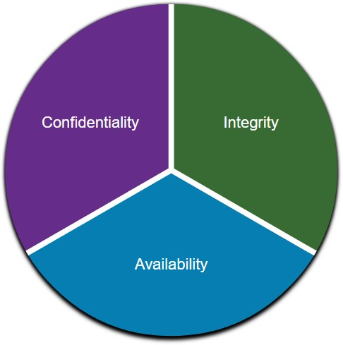
Communications Security: CIA
Information security deals with protecting information and information systems from unauthorized access, use, disclosure, disruption, modification, or destruction.
CIA Triad
The CIA triad consists of three components of information
security:
Confidentiality - Only authorized individuals, entities, or processes can access sensitive information.
Integrity - This refers to the protection of data from unauthorized alteration.
Availability - Authorized users must have uninterrupted access to the network resources and data that they require.

Slide 8
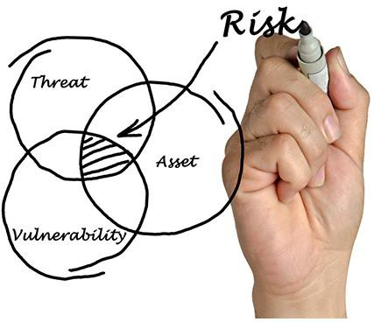
Threat, Vulnerability, and Risk
Attackers wants to access our assets such as data and other intellectual property, servers,
computers, smart phones, tablets, and so on.
TERM | EXPLANATION
Threat | A potential danger to an asset such as data or the network itself.
Vulnerability | A weakness in a system or its design that could be exploited by a threat.
Attack Surface | An attack surface is the total sum of the vulnerabilities in a given system that are accessible to an attacker. The attack surface describes different points where an attacker could get into a system, and where they could get data out of the system.
Exploit | The mechanism that is used to leverage a vulnerability to compromise an asset. Exploits may be remote or local. A remote exploit is one that works over the network without any prior access to the target system. In a local exploit, the threat actor has some type of user or administrative access to the end system. It does not necessarily mean that the attacker has physical access to the end system.
Risk | The likelihood that a particular threat will exploit a particular vulnerability of an asset and result in an undesirable consequence.

Slide 9
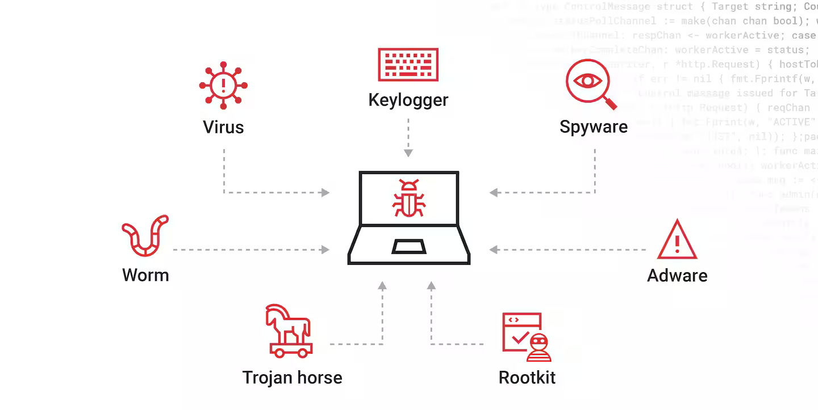
Malware definition
Malware is a code or software designed to damage, disrupt, steal, or do illegitimate action on data, hosts, or networks.
The three most common types of malware are Virus, Worm, and Trojan horse.

Slide 10
Malware types
Malware Type | Description
Virus | Attaches to legitimate programs or files and spreads when the infected file is executed.
Worm | Self-replicates and spreads across networks without user interaction.
Trojan | Disguises itself as legitimate software but contains malicious code to perform unauthorized actions.
Spyware | Secretly monitors and collects user information, often for surveillance or data theft.
Adware | Displays unwanted advertisements on the user's device, often slowing down performance.
Ransomware | Encrypts files or locks users out of their system until a ransom is paid.
Rootkit | Grants attackers administrative-level control over a system while remaining hidden.

Slide 11
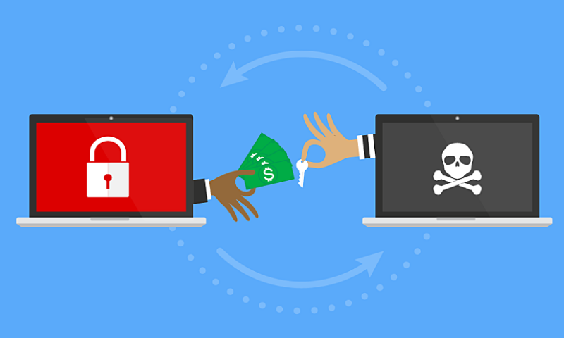
Ransomware
Ransomware is a malware that denies access to the infected computer system or its data.
Ransomware frequently uses an encryption algorithm to encrypt system files and data.
Email and malicious advertising, also known as malvertising, are vectors for ransomware campaigns.
Social engineering is also used, when cybercriminals pretending to be security technicians
make random calls at homes and persuade users to connect to a website that downloads ransomware to the user’s computer

Slide 12
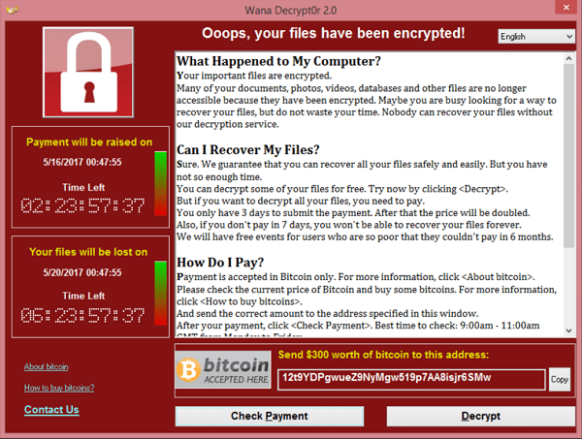
WannaCry Ransomware

Slide 13
Overview of Conti Ransomware
What is Conti Ransomware?
Conti is a highly sophisticated ransomware strain first identified in early 2020, known for its rapid deployment and extensive use of double extortion tactics, where data is both encrypted and threatened with public release.
Key Characteristics:
Targeted Attacks: Primarily focuses on high-value targets, including enterprises and critical infrastructure.
Speed and Efficiency: Capable of encrypting thousands of files in a matter of minutes.
Communication: Operates as a Ransomware-as-a-Service (RaaS), allowing affiliates to conduct attacks while the Conti group manages the backend.
Notable Incidents: in 2021, Conti attacked the Irish Health Service, disrupting healthcare services and leading to significant financial losses.
Attack Vector:
Often gains initial access through phishing emails, exploiting vulnerabilities, or using Remote Desktop Protocol (RDP).

Slide 14
Common Network Attacks
Attack Type | Description
Man-in-the-Middle Attack | Attacker intercepts and potentially alters communication between two parties.
Buffer Overflow Attack | Exploits a system by overloading a buffer to execute malicious code.
DoS Attack | Denies legitimate users access to a resource by overwhelming the system with traffic.
DDoS Attack | Similar to DoS but launched from multiple compromised devices to flood a target.
ICMP Attack | Exploits ICMP protocol (Ping) to overwhelm the target with echo requests.

Slide 15
Introduction to Network Discovery
Definition:
Network discovery is the process of identifying devices, services, resources, and vulnerabilities on a network.
Importance:
Provides visibility into network assets and vulnerabilities.
Essential for security assessments, vulnerability management, and compliance.
Helps in network planning, management, and optimization.

Slide 16
Key Network Discovery Techniques
Active Scanning
Description: Sends packets to various IP addresses to discover devices and open ports.
Tools: Nmap, Angry IP Scanner
Passive Scanning
Description: Monitors network traffic to identify devices and services without active probing.
Tools: Wireshark, PRTG Network Monitor
Network Mapping
Description: Creates a visual representation of the network topology to identify potential vulnerabilities.
Tools: SolarWinds Network Topology Mapper

Slide 17
Network Discovery Role in Incident Response
Initial Assessment: Quickly identifies affected devices and the scope of the incident.
Forensic Analysis: Helps trace back the attack path and understand the impact.
Vulnerability Assessment: Facilitates identifying unpatched systems and vulnerable services during a response.
Continuous Monitoring: Regularly use network discovery techniques to stay ahead of threats.
Integration with SIEM: Incorporate findings into Security Information and Event Management (SIEM) systems for better incident response.
Documentation: Keep detailed records of network configurations and changes for forensic readiness.

Slide 18
Phases of Incident Response

Slide 19
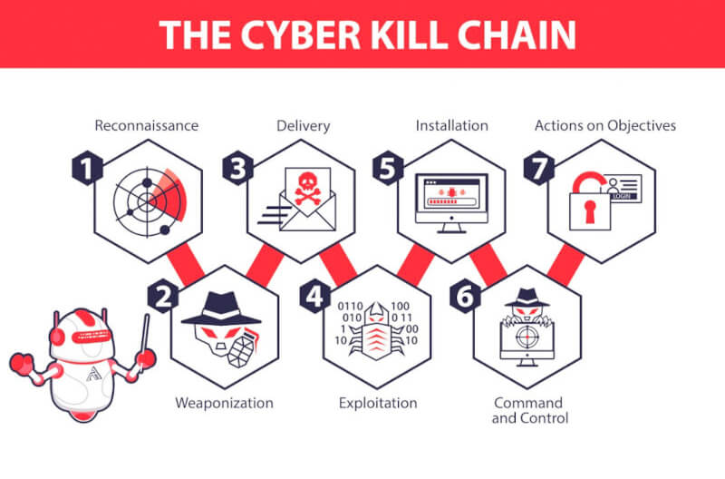
Cyber kill chain phases

Slide 20

Incident Response Plan (IRP): Preparation and Implementation
An introduction to the key elements and steps involved in preparing and implementing an effective Incident Response Plan to address security incidents and breaches.

Slide 21




Roles and Responsibilities
Incident Responders
Security Analysts
System Administrators
Management
Responsible for coordinating the immediate response to the incident, including containment, investigation, and mitigation efforts.
Responsible for analyzing security data, identifying threats, and providing recommendations to improve security posture.
Responsible for maintaining and securing the systems and infrastructure involved in the incident, and providing technical support to the incident response team.
Responsible for providing strategic direction, resources, and decision-making authority to the incident response team, as well as communicating with stakeholders.
Clearly defining the roles and responsibilities of each individual involved in the incident response process is crucial for an effective and coordinated response.

Slide 22



Communication Protocols
Reporting Procedures
Coordination Mechanisms
Establish clear guidelines for how to report security incidents, including designated points of contact, communication channels, and required information.
Implement coordination mechanisms, such as regular meetings, shared documentation, and communication tools, to ensure a cohesive and collaborative incident response effort.
Escalation Matrix
Develop an escalation matrix to determine when and how to elevate incident response activities to higher levels of management or specialized teams.
Incident Response Plan
Integrate incident response activities into a comprehensive plan that outlines the overall process, roles and responsibilities, and decision-making frameworks.
Effective communication protocols are essential for a successful and coordinated incident response. By establishing clear reporting procedures, escalation mechanisms, and coordination processes, organizations can enhance their ability to detect, respond to, and mitigate security incidents in a timely and effective manner.

Slide 23
Escalation Procedures
Define Incident Severity Levels
Establish a clear classification system to categorize incidents based on factors such as impact, urgency, and potential consequences. This could include levels ranging from low-impact/low-priority to high-impact/critical.
Establish Notification Thresholds
Determine the specific criteria that would trigger the escalation of an incident to the next level of management, such as the number of users affected, the business function disrupted, or the estimated financial or reputational impact.
Identify Escalation Contacts
Maintain a up-to-date directory of key stakeholders and decision-makers who should be notified in the event of an escalated incident, along with their contact information and preferred communication channels.
Outline Escalation Workflow
Document the step-by-step process for how incidents should be escalated, including who is responsible for initiating the escalation, the required approvals or authorizations, and the expected timeline for response and resolution.
Establish Communication Protocols
Define clear guidelines for how information about escalated incidents should be communicated, including the frequency of updates, the level of detail to be provided, and the preferred communication methods (e.g., email, conference calls, status reports).

Slide 24




Recovery Strategies
Backup Procedures
Disaster Recovery Plans
Contingency Planning
Restoration Strategies
Regularly backup critical data, systems, and configurations to secure off-site or cloud-based storage locations.
Establish comprehensive disaster recovery plans to ensure seamless restoration of systems and data in the event of an incident.
Develop detailed contingency plans to address various failure scenarios, including hardware/software failures, natural disasters, and cyber-attacks.
Outline step-by-step procedures for restoring systems and data from backups, ensuring a timely and effective recovery process.
By implementing robust recovery strategies, organizations can minimize the impact of incidents and ensure the continuity of their critical operations.

Slide 25



Regular Training
Educate Employees
Incident Recognition
Reporting Procedures
Conduct training sessions to educate employees about security best practices, such as identifying phishing attempts, creating strong passwords, and safely handling sensitive information.
Train employees to recognize signs of security incidents, such as suspicious emails, unauthorized access attempts, or unusual system behavior, and how to properly report them.
Ensure employees understand the established reporting procedures for security incidents, including whom to notify and how to escalate issues to the appropriate personnel.
Regular training is essential for maintaining a strong security culture within the organization. By educating employees on security best practices, incident recognition, and reporting procedures, you can empower them to be the first line of defense against cyber threats.

Slide 26



Awareness Campaigns
Regular Security Awareness Training
Informative Posters and Newsletters
Conduct frequent training sessions to educate employees on best practices, common threats, and their role in maintaining a secure environment.
Display posters and distribute newsletters highlighting security tips, policies, and incident reporting procedures.
Phishing Simulation Exercises
Security Awareness Contests
Simulate phishing attacks to assess employee preparedness and identify areas for improvement in spotting suspicious emails.
Organize contests and challenges to engage employees and reinforce security-conscious behaviors, such as password management or device locking.
By implementing a comprehensive awareness campaign, the organization can cultivate a security-conscious culture, empower employees to be vigilant, and reduce the risk of security breaches.

Slide 27




Phishing Simulations
Assess employee awareness
Customize scenarios
Track and analyze results
Provide feedback and training
Design phishing simulation campaigns that mimic real-world threats and tactics used by cybercriminals.
Monitor employee responses, identify training gaps, and measure the effectiveness of your phishing simulations.
Evaluate how well employees can identify phishing attempts and report suspicious emails or messages.
Offer educational resources and guidance to help employees improve their ability to recognize and report phishing attempts.
Conducting regular phishing simulations is a critical component of a comprehensive cybersecurity strategy, helping to strengthen employee vigilance and organizational resilience against phishing attacks.

Slide 28
Security Technologies
Security Information and Event Management (SIEM)
Centralized platform to collect, analyze, and correlate security-related data from various sources to detect, investigate, and respond to security incidents.
Intrusion Detection/Prevention System (IDS/IPS)
Monitors network traffic to identify and prevent suspicious activity, such as unauthorized access attempts, malware infections, and cyber attacks.
Firewall
Establishes a barrier between a trusted, internal network and an untrusted, external network, controlling and monitoring incoming and outgoing traffic based on predefined security rules.
Antivirus Software
Detects, prevents, and removes malware, such as viruses, worms, and Trojans, to protect your systems and data from unauthorized access and damage.
Data Loss Prevention (DLP) Solution
Monitors, detects, and prevents the unauthorized access, use, or transmission of sensitive or confidential data, ensuring data security and regulatory compliance.

Slide 29


Partnerships
Law Enforcement Collaboration
Cybersecurity Expert Networking
Industry Association Engagement
Establish communication channels with local, state, and federal law enforcement agencies to facilitate timely incident reporting and coordinate response efforts.
Engage with cybersecurity experts, such as incident response teams and threat intelligence analysts, to share threat information and best practices for prevention and mitigation.
Participate in industry-specific associations and forums to collaborate with peers, stay informed on emerging threats, and collectively develop strategies to address common security challenges.
By fostering partnerships across law enforcement, cybersecurity experts, and industry associations, organizations can build a comprehensive and coordinated approach to incident response, leveraging shared knowledge and resources to enhance their overall cybersecurity posture.

Slide 30

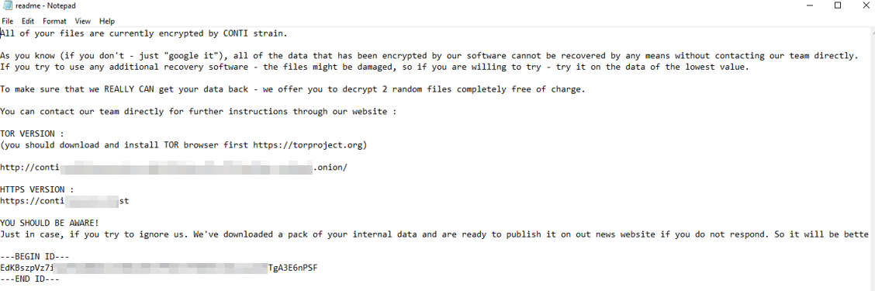
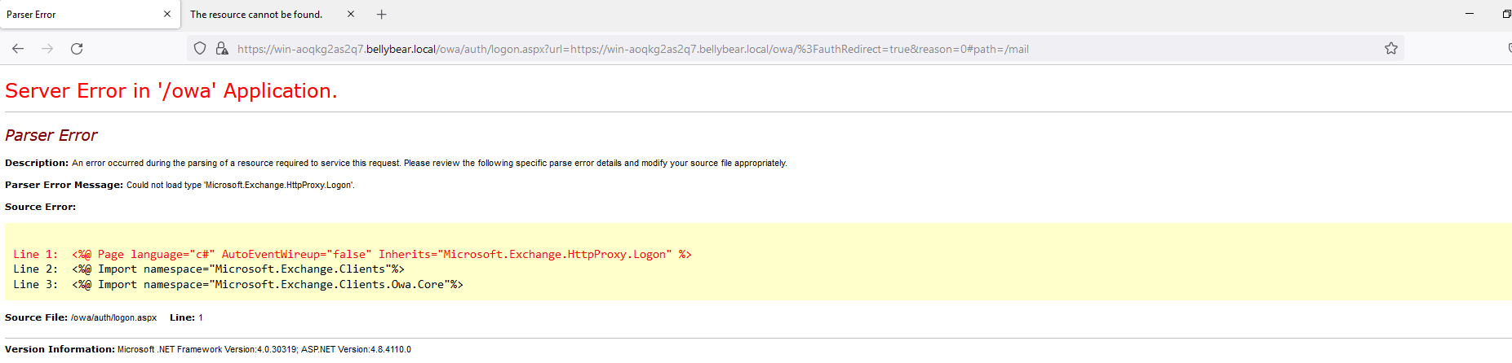
Service Outage!

Slide 31
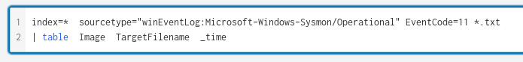
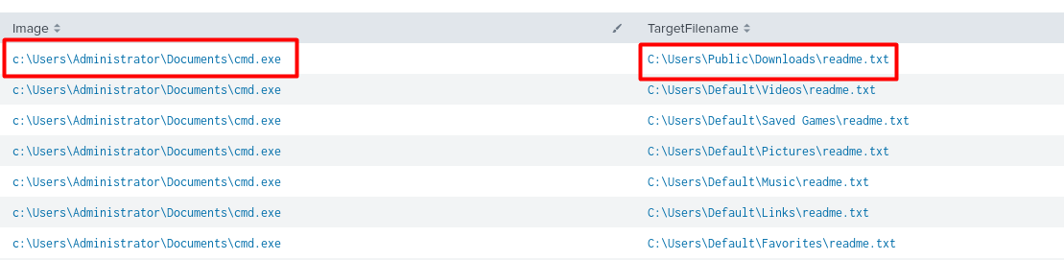
Conti_ransomware_note.txt

Slide 32
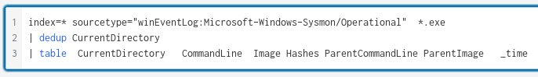
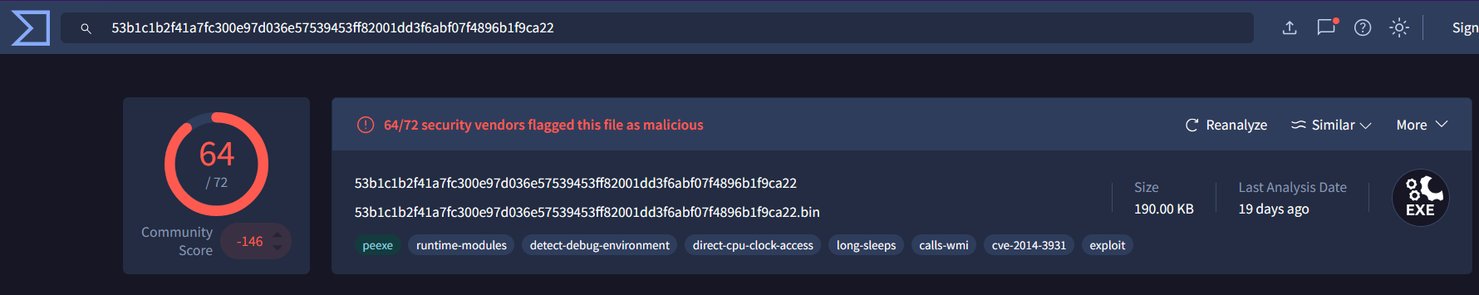
Ransomware ?!
Splunk Query:

Slide 33
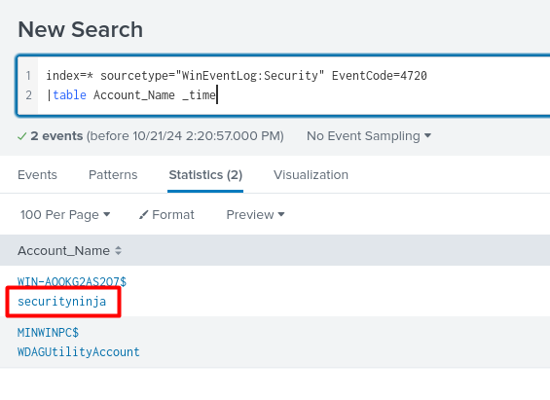
New user creation !!!

Slide 34
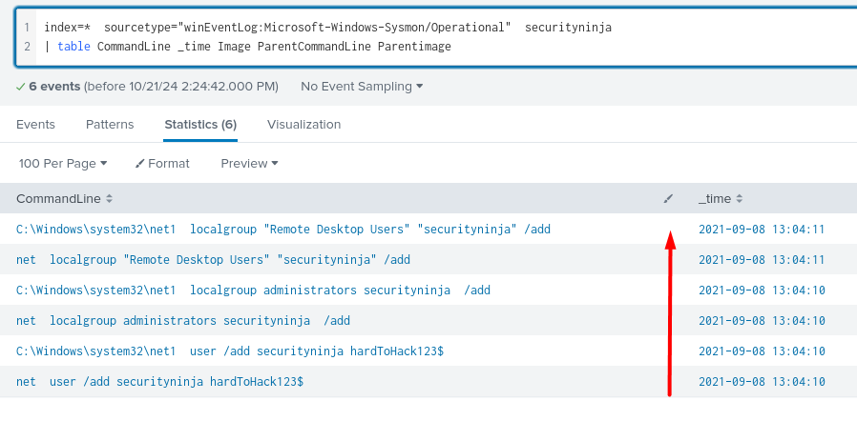
Assigning the new user to interesting groups

Slide 35
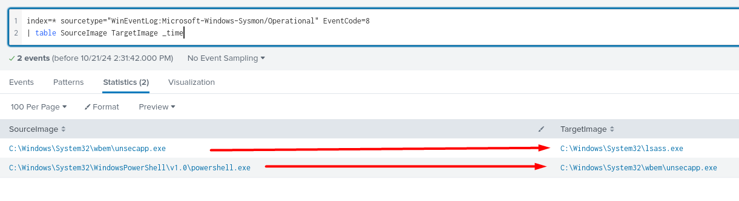
Privilege Escalation !!!
CreateRemoteThread

Slide 36
What is lsass.exe ?
Managing user logins and logouts
Authenticating users and services
Handling password changes and password policies
Contains the password of users in hash format

Slide 37
Why migrating to lsass.exe ?
Elevated Privileges: higher privilege
Persistence: less likely to be terminated
Stealth: hiding within a legitimate system process
Access to Credentials: ability to access and steal stored credentials
Lateral Movement: using the harvested credentials
Data Exfiltration: send sensitive back to the attacker

Slide 38
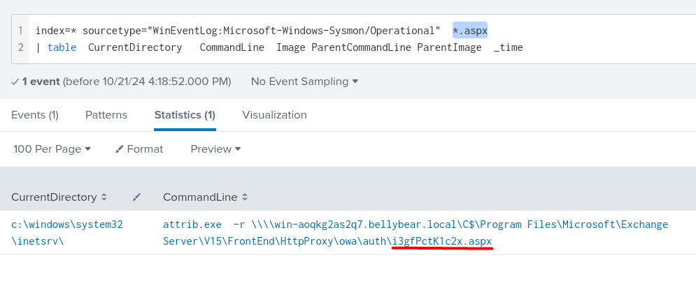
Conti uses Web Shell ?!

Slide 39
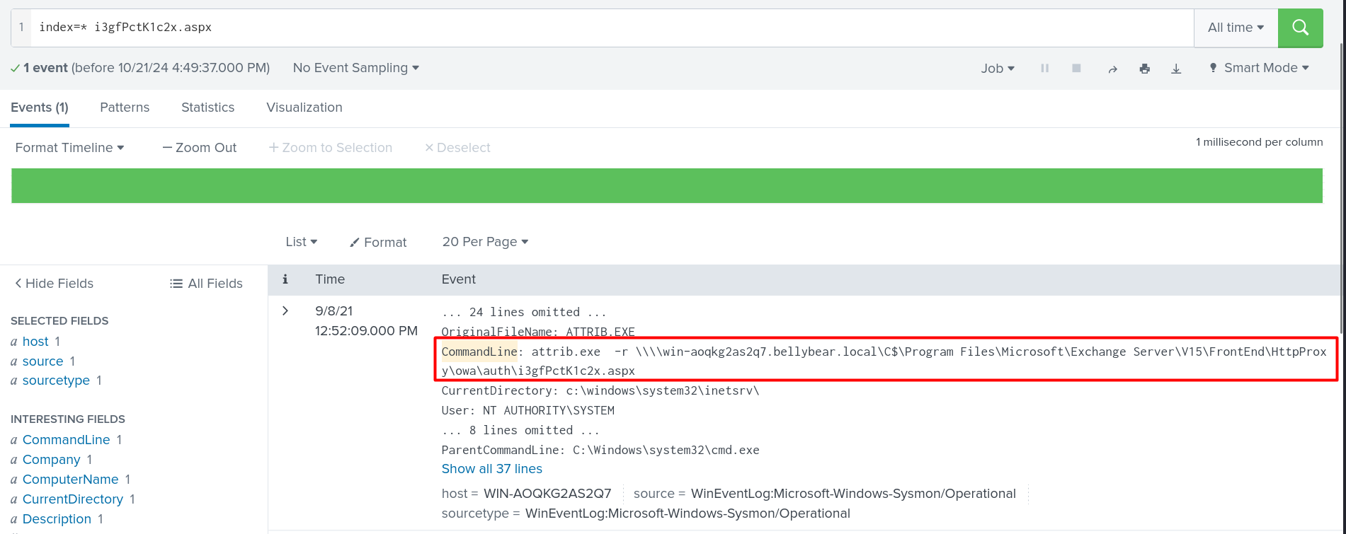
Weaponizing a shell !

Slide 40

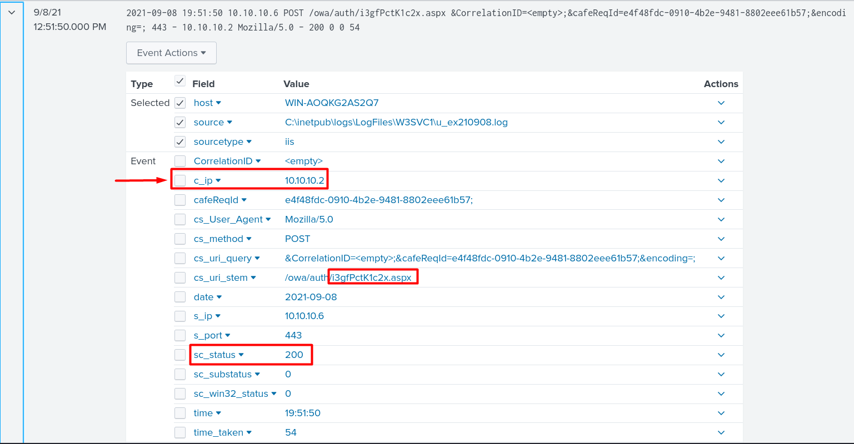
delivery !!

Slide 41
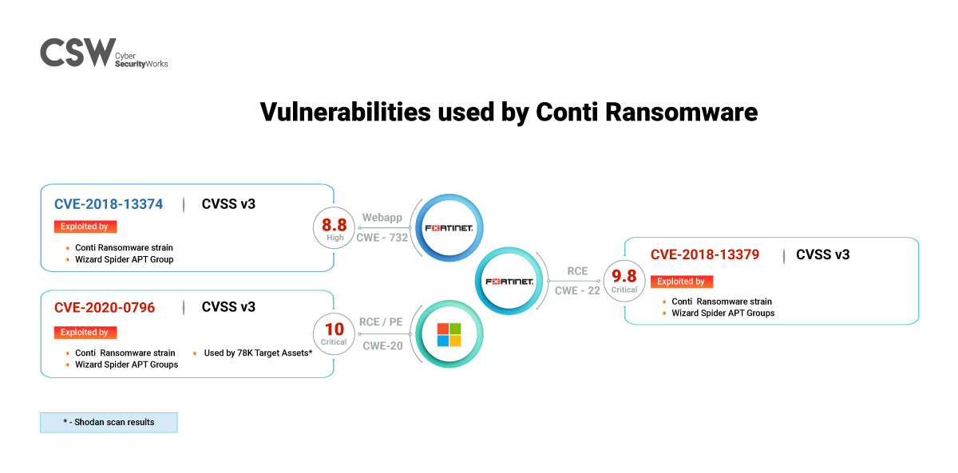
Conti CVEs !
CVE-2020-0796: The attack showed lateral movement across systems, evidenced by the attacker migrating processes and escalating privileges using commands like: net user /add and net localgroup administrators /add
CVE-2018-13374 and CVE-2018-13379: The web shell (i3gfPctK1c2x.aspx) was deployed on the Exchange server through a vulnerability that enabled unauthorized file upload and execution.

Slide 42
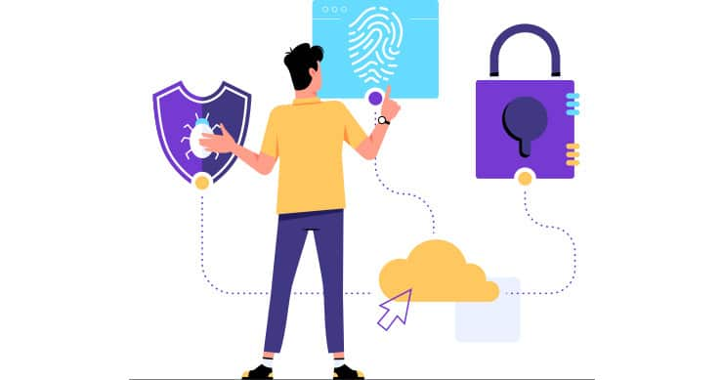
Post-Incident Activity Documentation for Conti Ransomware Attack Introduction This document outlines the post-incident activities following the Conti ransomware attack. The primary goal is to review the incident, assess its impact, document lessons learned, and implement improvements to prevent future occurrences. Objectives of Post-Incident Activity Evaluate Incident Response: Analyze the effectiveness of the response to identify strengths and weaknesses. Document Findings: Capture detailed information about the attack, including indicators of compromise (IOCs) and its impact. Identify Lessons Learned: Extract insights from the incident to enhance future preparedness and response. Strengthen Security Measures: Update policies and procedures based on insights gained from the incident. Improve Training and Awareness: Educate staff regarding ransomware threats and incident response.

Slide 43
Review the Incident Timeline: Detection: Date & Time: Initial reports of users being unable to access Outlook and the Exchange Admin Center. Initial Indicators: Discovery of ransom notes on the Exchange server indicating a breach.
Recovery Efforts:
Restoration of services using clean backups and patching of exploited vulnerabilities.
Response Actions:
Immediate isolation of affected systems.
Notifications to key stakeholders and initiation of incident response protocols
Analyze Response Effectiveness:
Strengths:
Quick identification of the attack and isolation of affected systems.
Effective communication among the incident response team.
Weaknesses:
Delayed identification of the initial attack vector.
Insufficient initial scope assessment, leading to prolonged recovery.

Slide 44
Document Findings
Create a Comprehensive Incident Report:
Incident Overview:
Type of Attack: Ransomware (Conti).
Delivery Method: Phishing email containing malicious links, exploiting vulnerabilities in the Exchange Server.
Impact Assessment:
Systems Affected:
Exchange Server.
User workstations.
Data Loss:
Potential encryption of critical files and ransom demands issued by attackers.
Downtime:
Service outages affecting email communication for approximately 72 hours.
Financial Implications:
Estimated costs for recovery efforts, potential ransom payments, and reputational damage.
Identify Indicators of Compromise (IOCs):
Malicious File Paths:
C:\Users\Administrator\Documents\cmd.exe (ransomware executable).
MD5 Hashes:
290C7DFB01E50CEA9E19DA81A781AF2C (hash of the ransomware executable).
Malicious Domains:
malicious-domain.com (replace with actual domains used by the attackers).
IP Addresses:
192.0.2.1 (example IP used for command-and-control communication).
File Names:
readme.txt (ransom note distributed across folders).
i3gfPctK1c2x.aspx (malicious web shell deployed on the server).

Slide 45

Lessons Learned Document Action: Summarize key takeaways for future reference. Findings: Highlighted the importance of regular backups, timely patching, and employee training on cybersecurity best practices

Slide 46
Identify Lessons Learned Recognizing Phishing Threats: Lesson: The phishing email that initiated the attack was not identified promptly. Action: Implement enhanced email filtering and user training on recognizing phishing attempts. Vulnerability Management: Lesson: Critical vulnerabilities in the Exchange Server were exploited due to outdated patches. Action: Establish a regular patch management schedule and ensure timely updates for all systems. Incident Detection: Lesson: Initial detection relied heavily on user reports rather than proactive monitoring. Action: Improve monitoring capabilities with SIEM tools to detect anomalies in real-time. Communication Protocols: Lesson: Communication during the incident was not as streamlined as needed. Action: Develop clear communication protocols for incident response, including designated spokespeople and channels. Response Time: Lesson: The response time could have been improved with better preparation. Action: Conduct regular tabletop exercises to rehearse the incident response plan and improve reaction times.

Slide 47
Enhance Security Measures
Update Incident Response Plans:
Revisions: Incorporate lessons learned from the Conti attack into the incident response plan.
Contact Information: Ensure all contact details for team members are up-to-date.
Roles and Responsibilities: Clearly define roles for each team member during incident response.
Implement Technical Controls:
Patch Vulnerabilities:
Exchange Server: Apply security patches for vulnerabilities exploited during the attack.
Network Segmentation:
Isolate critical infrastructure from less secure networks to limit lateral movement.
Strengthen Access Controls:
Multi-Factor Authentication (MFA):
Implement MFA for all critical systems, especially for administrative access.
Review User Privileges:
Conduct an audit of user accounts and privileges to ensure least privilege access.
Enhance Endpoint Protection:
Deploy EDR Solutions:
Implement Endpoint Detection and Response (EDR) tools to monitor for suspicious activities.
Ensure Antivirus Solutions:
Keep all endpoints equipped with updated antivirus solutions.
Step 5: Conduct Training and Awareness Programs
Employee Training:
Workshops: Organize mandatory training sessions to educate staff on recognizing phishing emails and social engineering tactics.
Incident Response Training: Provide training on updated incident response procedures and protocols.
implement Continuous Monitoring:
SIEM Tools: Utilize Security Information and Event Management (SIEM) tools to continuously monitor for indicators of compromise (IOCs) related to the Conti attack.
Alerting Mechanisms: Set up alerts for specific IOCs, such as:
Unauthorized account creations.
Suspicious file modifications or deletions.

Slide 48






System Hardening
Update and Patch Regularly
Firmware Updates: Ensure the firewall firmware is always up-to-date with the latest security patches.
Regular Patching: Apply patches promptly to address any vulnerabilities.
Configure Rules and Policies
Least Privilege: Implement the principle of least privilege by allowing only necessary traffic.
Deny by Default: Set default policies to deny all traffic and explicitly allow only required services
Implement Advanced Features
Intrusion Prevention Systems (IPS): Use IPS to detect and block malicious activities.
Application Layer Filtering: Implement application layer filtering to inspect and control traffic based on application data.
Configuration Changes for Firewalls
Enable Logging and Monitoring
Regular Audits
Conduct regular audits of firewall logs to detect and respond to suspicious activities
Detailed Logs Enable detailed logging to monitor all traffic passing through the firewall.
.

